Slide 1
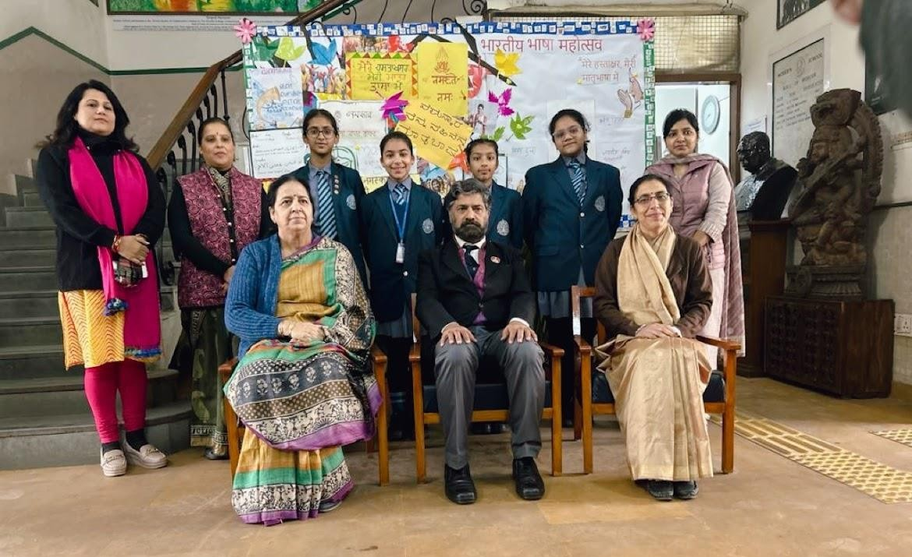
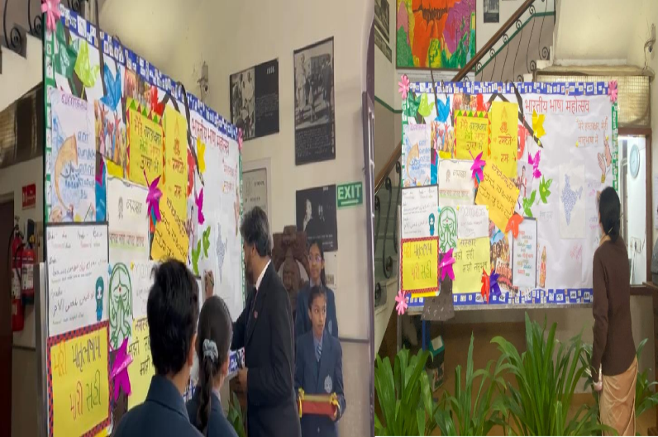
ISSUE 404: 19TH TO 25TH FEBRUARY 2024
CHRONICLE
THE MODERN SCHOOL WEEKLY
MODERN SCHOOL, BARAKHAMBA ROAD
www.modernschool.net ESTD 1920
Bharatiya Bhasha Mahotsav
The Department of Hindi language at Modern School, Barakhamba Road, dedicated a week from 7th to 13thDecember, 2023,for classes VIth to Xth in the honour of Shri Subramania Bharattiji by organising various activities like reading, writing and poetry recitation. The entire programme was organised under the leadership of the head of the department, Ms Manju Vijra.
Over the weekend innovative and outstanding essays were written by the students in twenty-two Indian Languages. The event was concluded by parents and teachers signing their names in their regional native language like Bengali, Punjabi etc.. on the display board. The Principal Dr Datta and the department of Hindi language appreciated the students participation in the event and encouraged them to partake in future event with similar enthusiasm.
What's New At Modern..
Bharatiya Bhasha Mahotsav Pg 1
Youth Eco Summit Pg 2
Mock Evacuation Drill Pg 2
Sai Global Debate Round Square Pg 3
Nature Club: STEM Pg3
Creative Corner Pg 4
PAGE 1

Slide 2
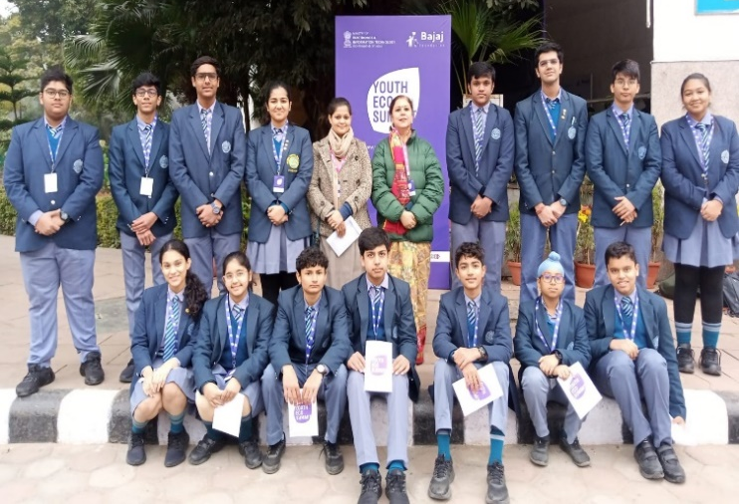
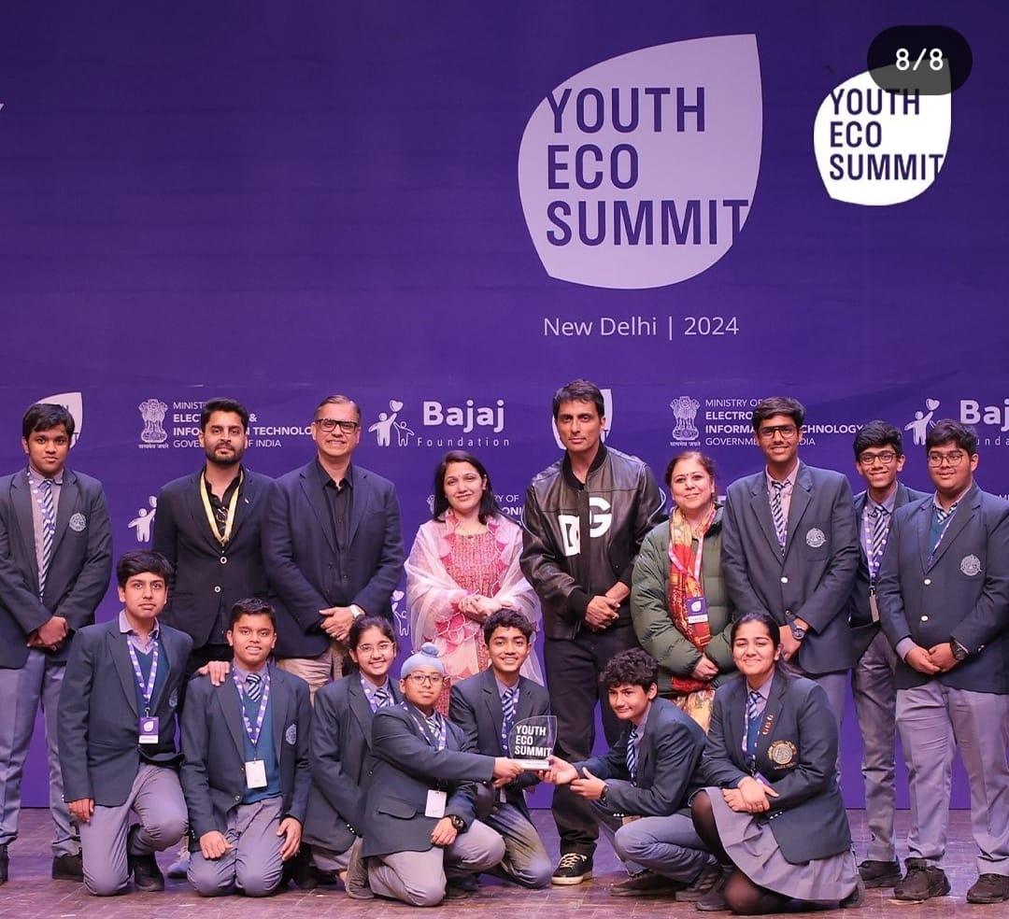
ISSUE 404: 19TH TO 25TH FEBRUARY 2024
Youth Eco Summit
Modern School Delegation, along with Nature Club In charges
Modern School Students, being awarded as EcoChampions
Nature Club of Modern School, Barakhamba Road, participated in India's first Youth Eco Summit, hosted by the Bajaj Foundation, a groundbreaking initiative dedicated to E-waste awareness, advocacy, and action. The event was hosted at Siri Fort Auditorium, New Delhi on 18th January, 2024, and was aided by Ministry of Electronics and Information Technology, Government of India. Fifteen students from class IX and XI along with Nature Club In charges Ms Richa Bhatia and Ms Priyanka Singh attended the summit. The interactive sustainability event aimed to ignite the inventive spirits of young minds, urging them to craft innovative solutions for the pressing concern of electronic waste threatening our enviroment.
On the day of the event, a Panel discussion on “One World, One Family: Community, Industry, Government,” was held with eminent speakers and key stakeholders on raising awareness on
e-waste. The panel included Mr Pankaj Bajaj(Founder, Bajaj Foundation), Mr Sonu Sood(Humanitarian), Mr Abhiir Bhalla(Youth Environmentalist), Mr Suneel Pandey(Director, TERI), Mr Nitin Pramod(IFS, Government of India), Ms Anamika Narwal(IFS, Government of India). Keynote address was given by Mr Darrin Farrant(Director, UN Information Centre) and Mr Satish Upadhyay(Vice Chairman, NDMC).Students participated in On-the-spot Quiz enthusiastically. Two models made by Modern School students on Waste to Art were displayed at the event. Modern School, Barakhamba Road was given Eco Champions Award to celebrate the initiatives taken by the school for a sustainable future. The event served the young minds with the knowledge and awareness to become the eco-warriors, our planet desperately needs.
Mock Evacuation Drill
On 25th January, 2024, a Mock Evacuation Drill was conducted in the School to provide training and guidelines to students and members of staff about the do’s and don'ts in case of a fire incident. Evacuation routes and exit gates had been explained to them beforehand. The Fire Alarm was rung at 1:45 pm and the buildings were evacuated in less than two minutes. All students and teachers assembled in the lower field.
Students and teachers assemble in the lower field
PAGE 2

Slide 3
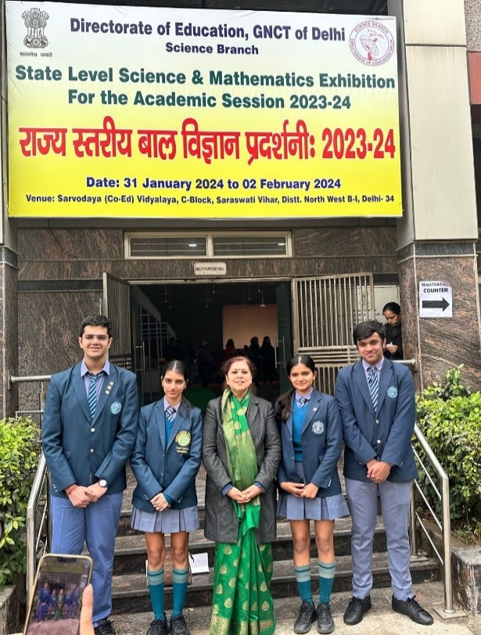
ISSUE 404: 19TH TO 25TH FEBRUARY 2024
SAI Global Debate 2024 for Round Square Schools
The Students of Modern School, Barakhamba Road, participated in the 3rd edition of the esteemed SAI Global Debate on 27th January, 2024, showcasing their exceptional debating skills and contributing to a remarkable learning experience for all . The Modern School delegation comprised of Anirudh Tewari(VII-D), Ananmay Aggarwal(VII-H), Ananya Rajan(VIII-H) and Tisyaa
Gupta(VIII-C) competing in the Junior Category; and Aashree Jain(XI-F),Krish Wallia(XI-H), Sumia Jain(XI-H), and Saira Chadha(XI-I) competing in the senior category. The event provided a platform for students from over thirty-five schools across the continent, to engage in thought-provoking discussions on global issues. The broad themes for the events were “Sustainable goals – marching towards real development” and “Artificial Intelligence and the Next Century”. Ten representatives of Modern School qualified for the Final Round, and Krish Wallia(XI-H) bagged the Second Position in the Extempore Senior event.
Enthusiastic Round Square Delegation
The delegation left a lasting impression on both, the judges and fellow participants with their eloquence, depth of knowledge, and ability to articulate compelling arguments.
Nature Club : STEM Exhibition
The Nature Club of Modern School, Barakhamba Road, visited the State Level Science Exhibition for the Green School Competition organised by the Directorate of Education on 31st January, 2024, at the Sarvodya Vidyala, New Delhi. Raghav Singhal(XI-G), Tanay Jalan(XI-A), Ayra Goel(XI-F) and Inayatt Gogia(XI-I) attended the exhibition. The students took ten varieties of plants which included the Pink rose plant, Peace lily plant and Lolina plant as a symbol of the school’s dedication and effort towards the environment. The exhibition encompassed different branches of science, technology, engineering, and mathematics (STEM). Students were guided through an immersive journey that covered diverse topics and models, ranging from chemistry to biology, robotics, and environmental science.
Overall, the event represented the significant scientific exploration. It was an enriching experience for the students.
Modern School Delegation
PAGE 3

Slide 4
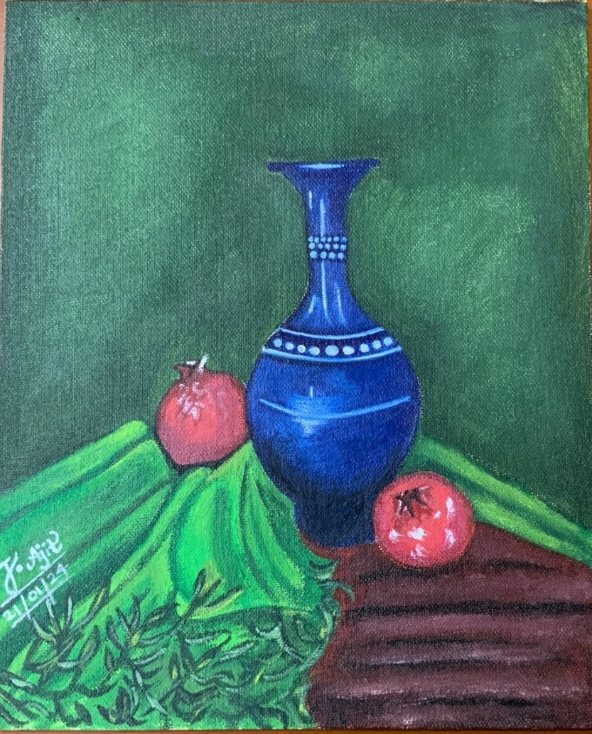
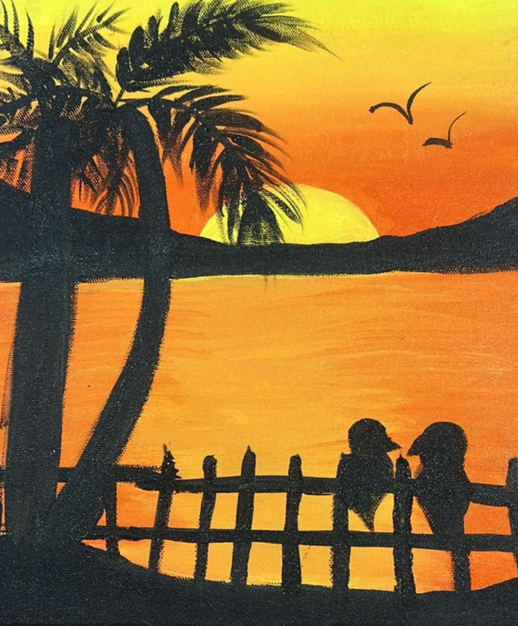
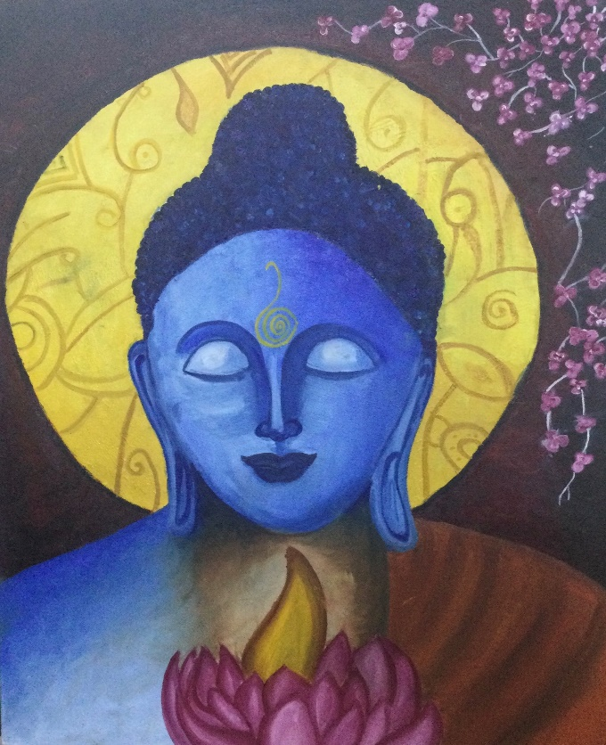
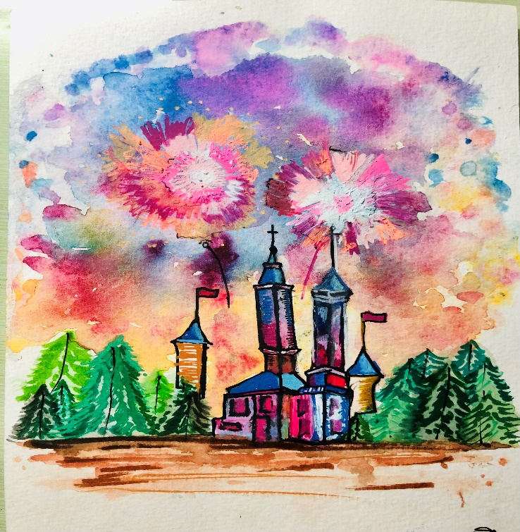
ISSUE 404: 19TH TO 25TH FEBRUARY 2024
Creative Corner
Ishana Ajit Kumar(IX-D)
Shanaya Kochhar(VI-F)
Naisha Kaur Johar(VI-B)
Ojas Khandelwal(VII-C)
----------------------------------------------------------------------------------------------
COMPILED BY: Ms Bhavna Hingle
SUPERVISED BY:
Ms Namrata Sanghi
PAGE 4

